Slide 1
SHAP values plots

Slide 2
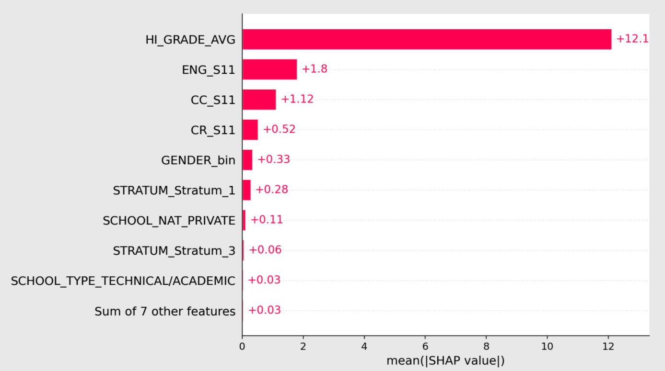
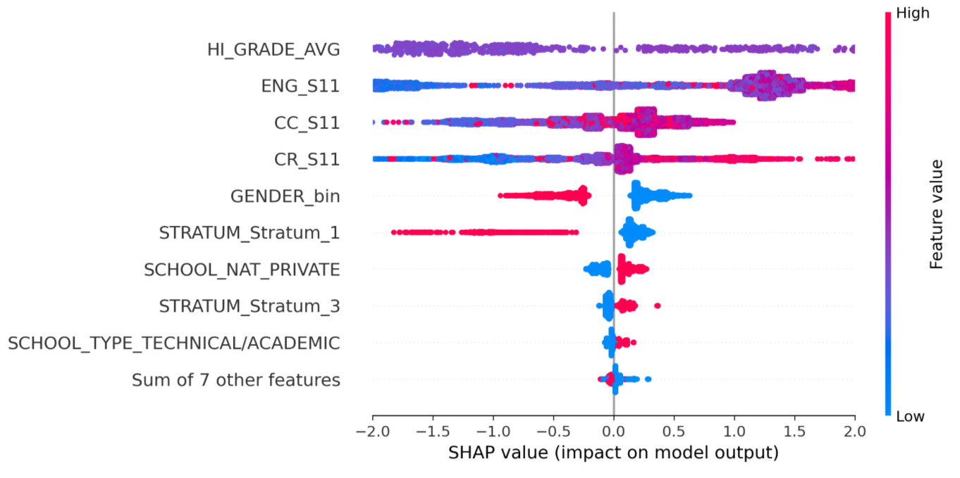
Df=GUDF (avg of 3, 3 individual, stratum, school type, school nature, gender) Standardized - all
Notes:
Here we see, that the gender is the 4th most impactfull attribute.

Slide 3
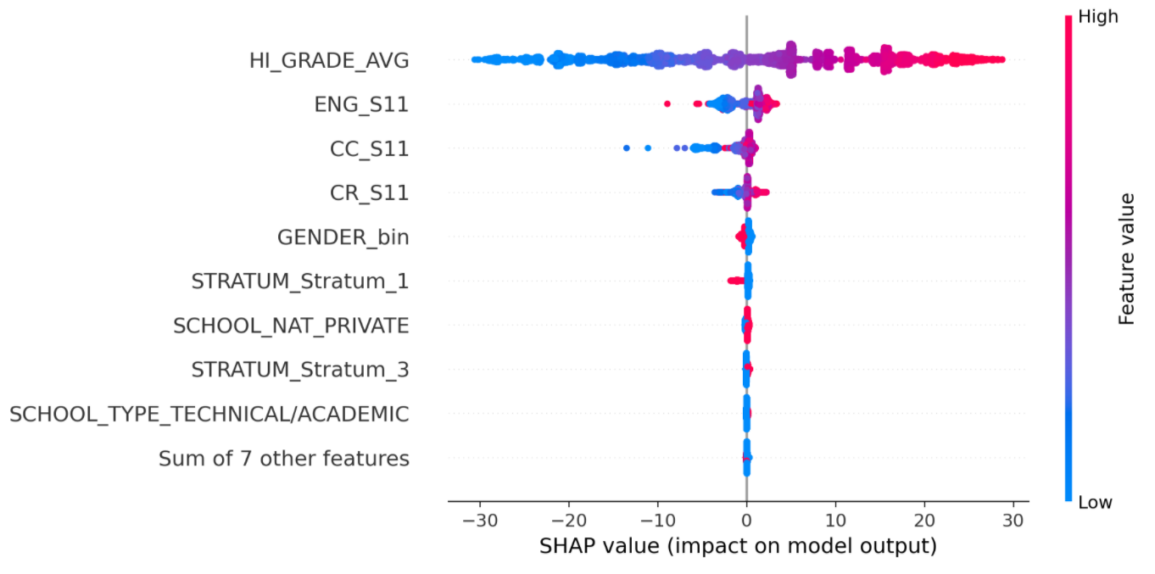
The full plot

Slide 4
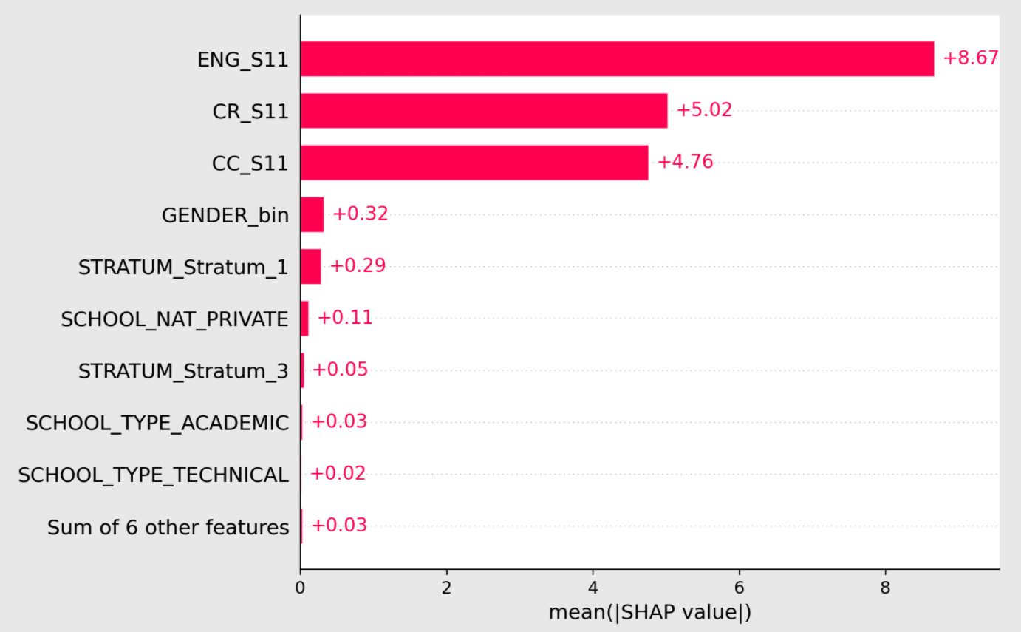
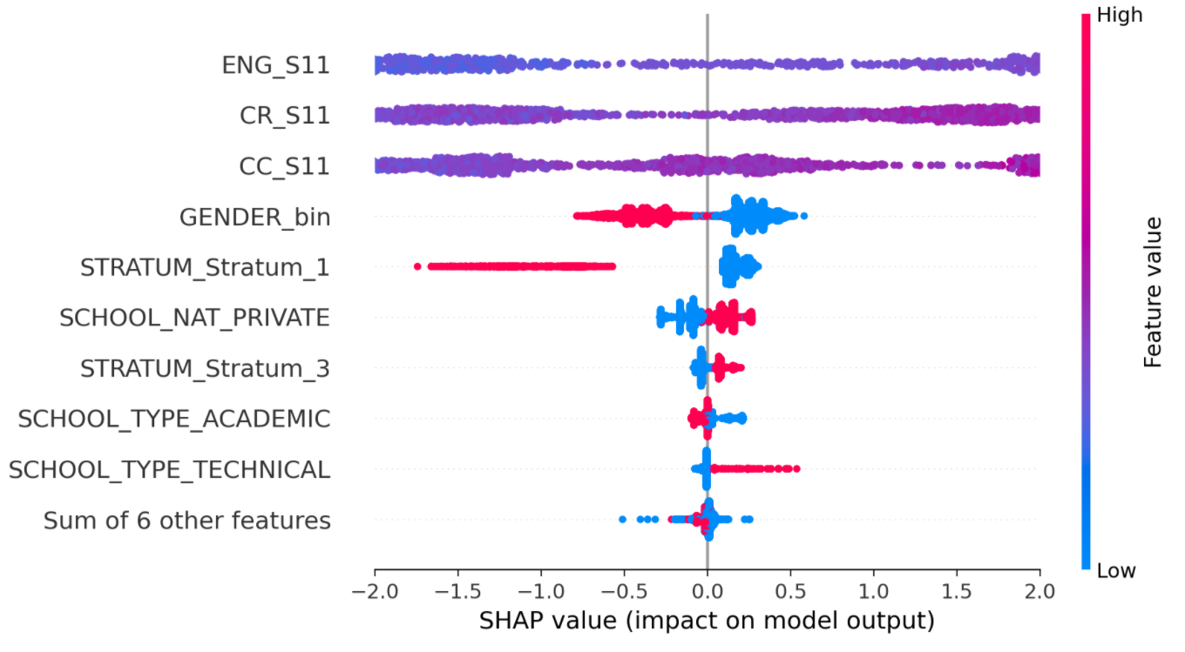
Df=GUDF (3 individual, stratum, school type, school nature, gender) Standardized - without avg

Slide 5
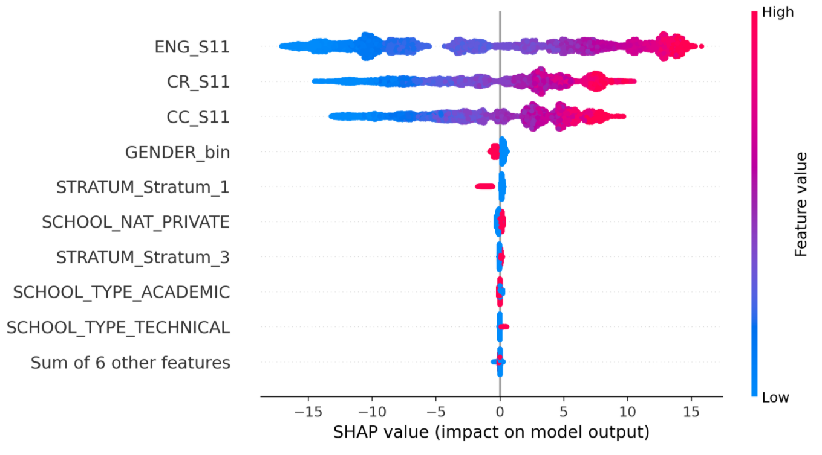
The full plot

Slide 6
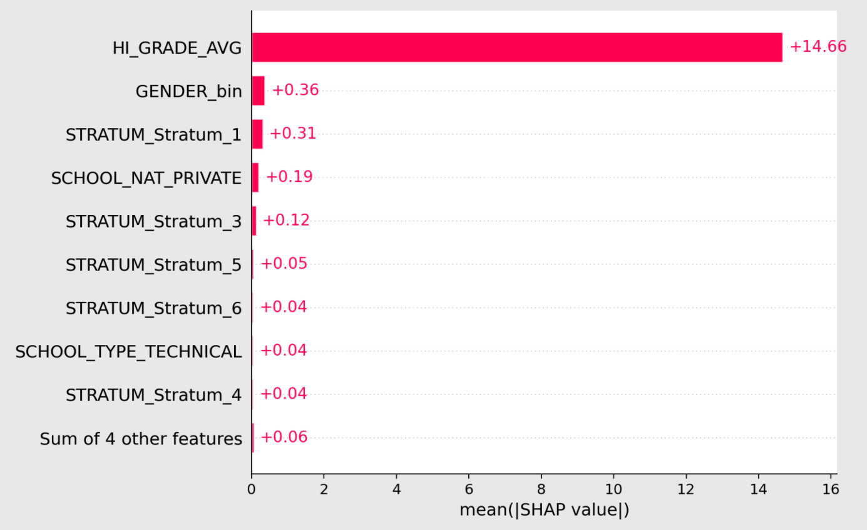
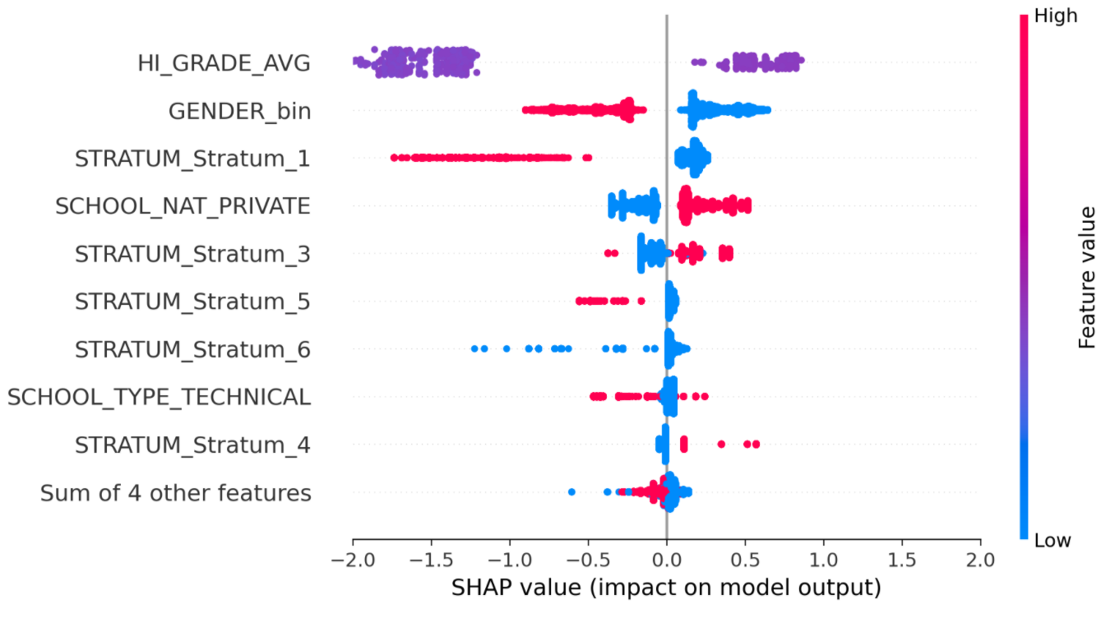
Df=GUDF (avg of 3, stratum, school type, school nature, gender) Standardized - without individual

Slide 7
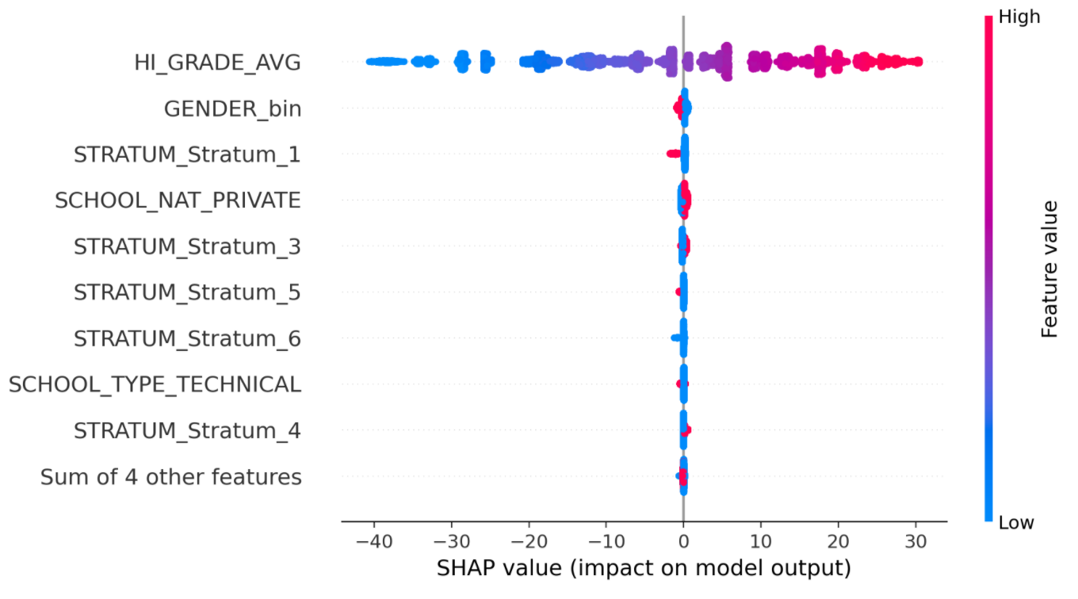
The full plot

Slide 8
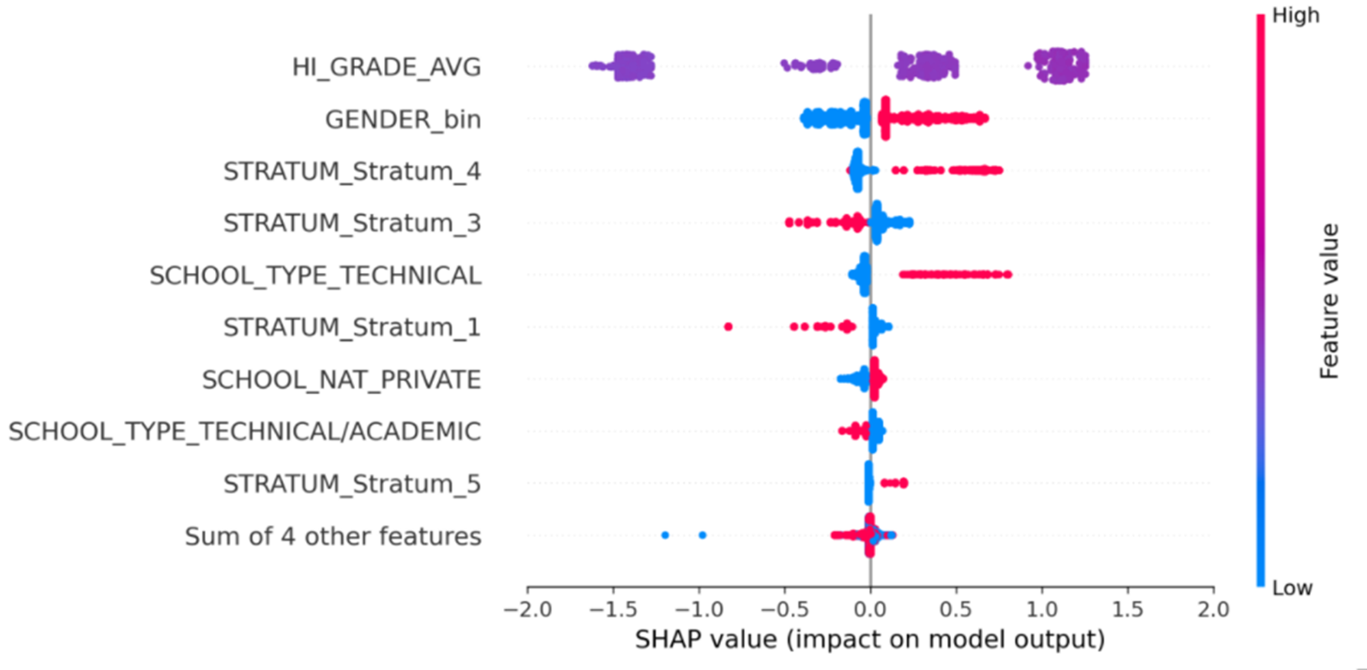
Df=(avg of 5, stratum, school type, school nature, gender) Standardized - avg of 5 wihtout indivi.

Slide 9
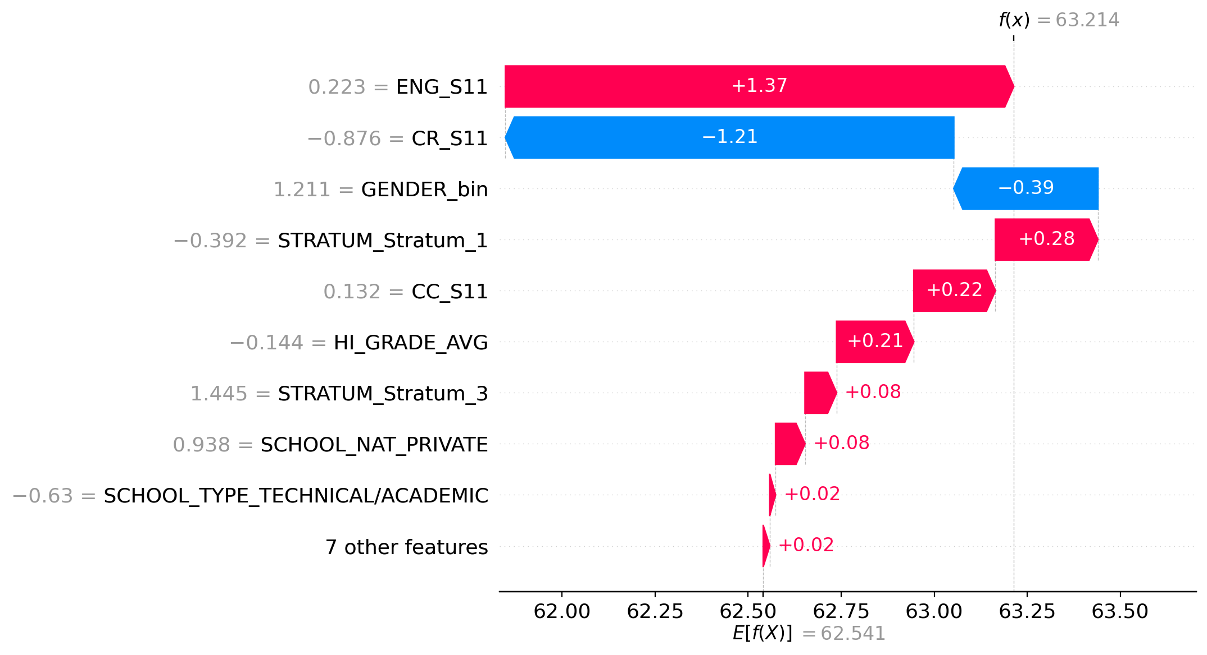
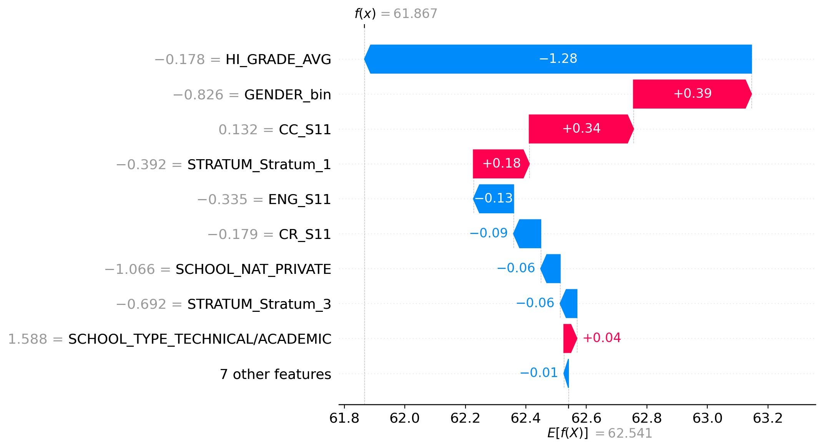
Examples for 3 avg, 3 indivi, etc.

